Slide 1
Supervised Learning I

Slide 2
The Problem
This time we have the inputs and the ground truth given to us
In RL: ground truth came in a few forms:
Bellman Equation w/ Rewards
Policy Gradients
Here ground truth is known and fixed
Pro: we don’t have to worry about generating it
Con: what is the “quality” of the dataset that we have?

Slide 3
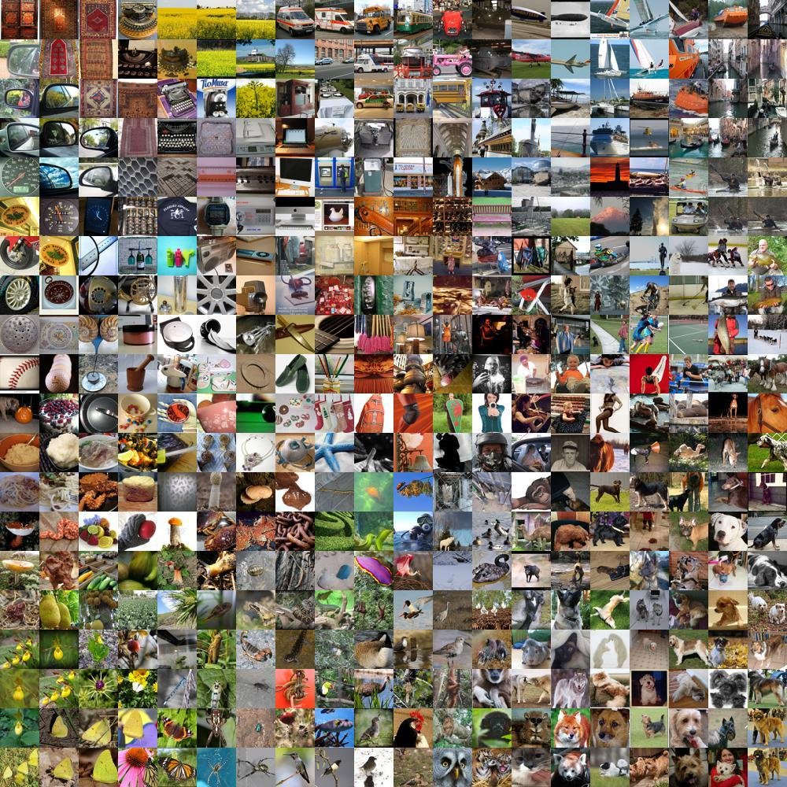
Example
Task: Classify natural images into one of 1000 categories
(ImageNet 1k)
The dataset:
14.2M images (standard size, subject centered)
Each image has a label (the category of that image)
Is this representative of natural images?
How many natural images could exist?
What are “hard” images from “easy” images?

Slide 4
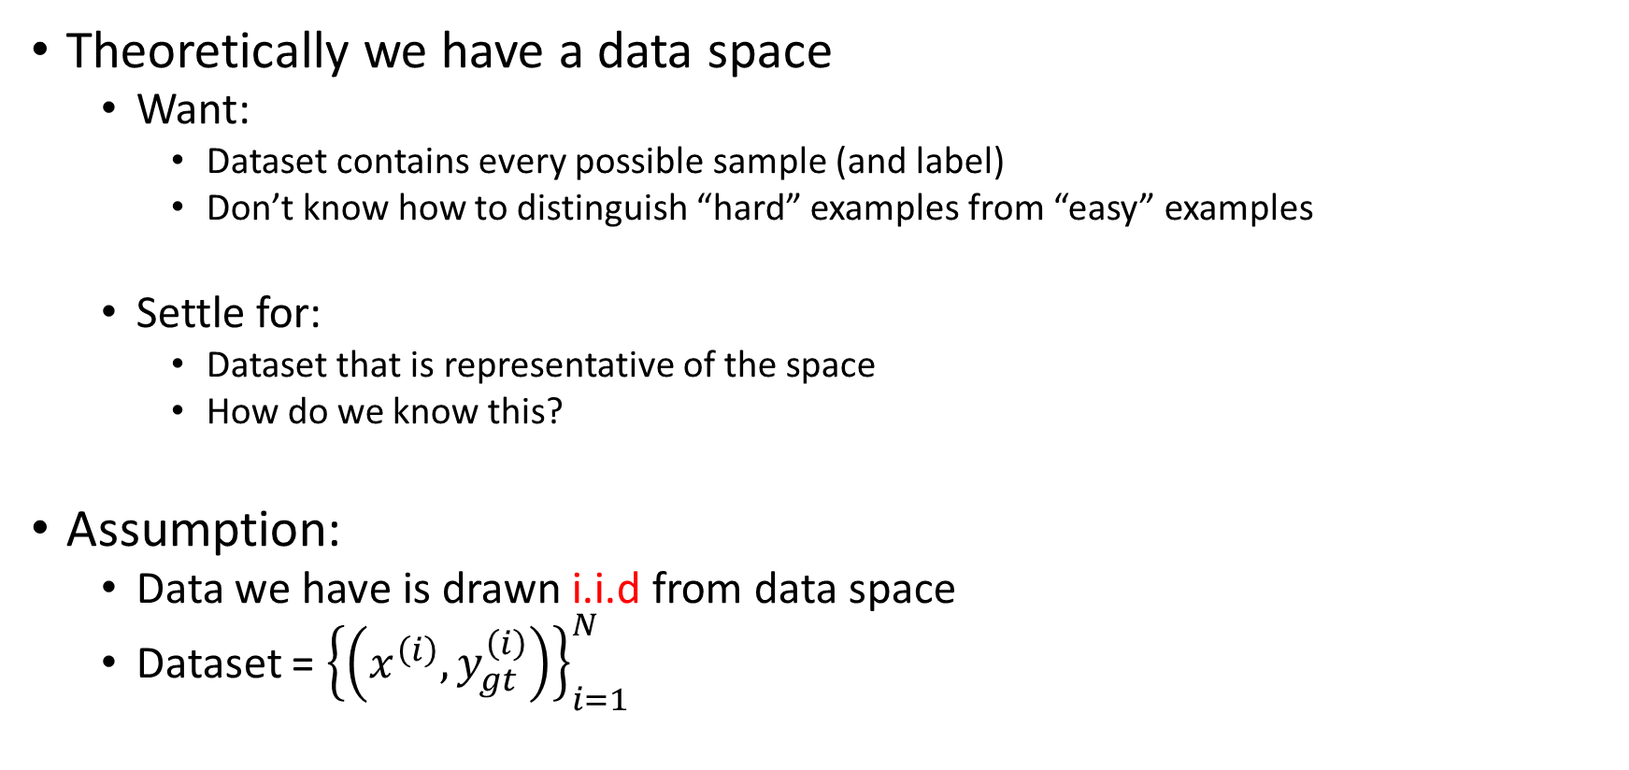
The Data
Theoretically we have a data space
Want:
Dataset contains every possible sample (and label)
Don’t know how to distinguish “hard” examples from “easy” examples
Settle for:
Dataset that is representative of the space
How do we know this?
Assumption:
Data we have is drawn i.i.d from data space
Dataset = ${\left\{\left(x^{\left(i\right)}, y_{gt}^{\left(i\right)}\right)\right\}}_{i=1}^{N}$

Slide 5
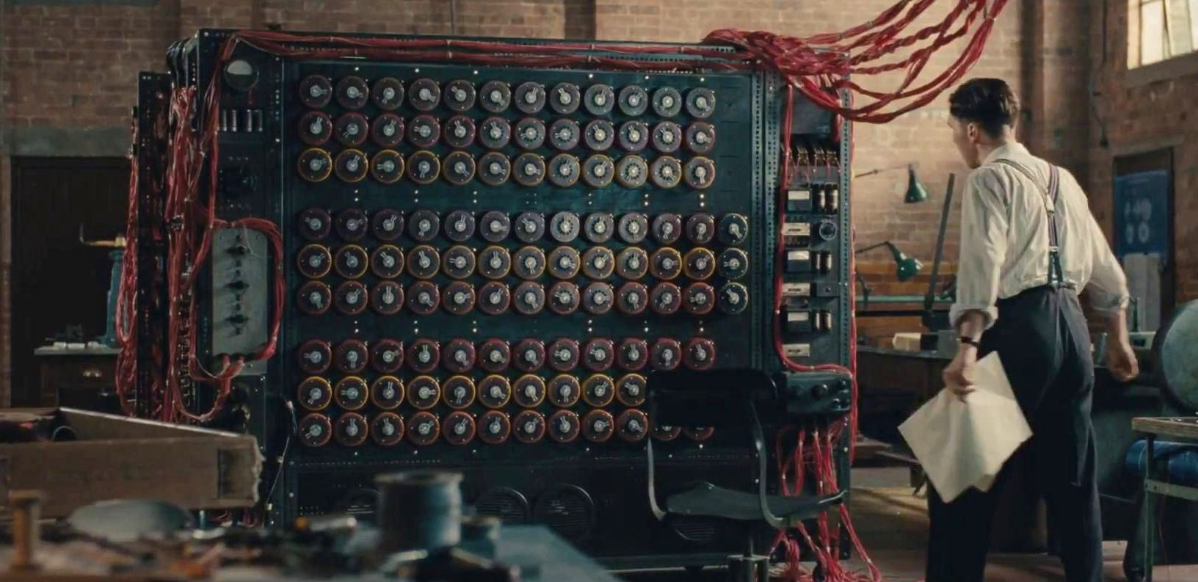



The Goal
Learn the function $f_{θ}:X→Y$ which maps examples to their ground truth
Typically parameterize $f$: goal becomes learn the parameters $θ$
$$x^{(i)}$$
$${\hat{y}}^{(i)}$$

Slide 6
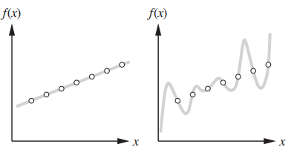

The Hypothesis Space
If we have $N$ data points, what functions could we learn?
Goal: search through possible functions to select the best one

Slide 7
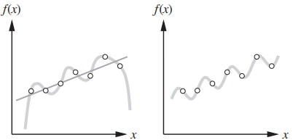
The Goal Pt 2
One important factor we forgot to mention:
Since our data is (most likely) not the entire data space
AND we have no way to check if it is representative
We want our function to generalize
The function needs to perform well on data it hasn’t seen before

Slide 8
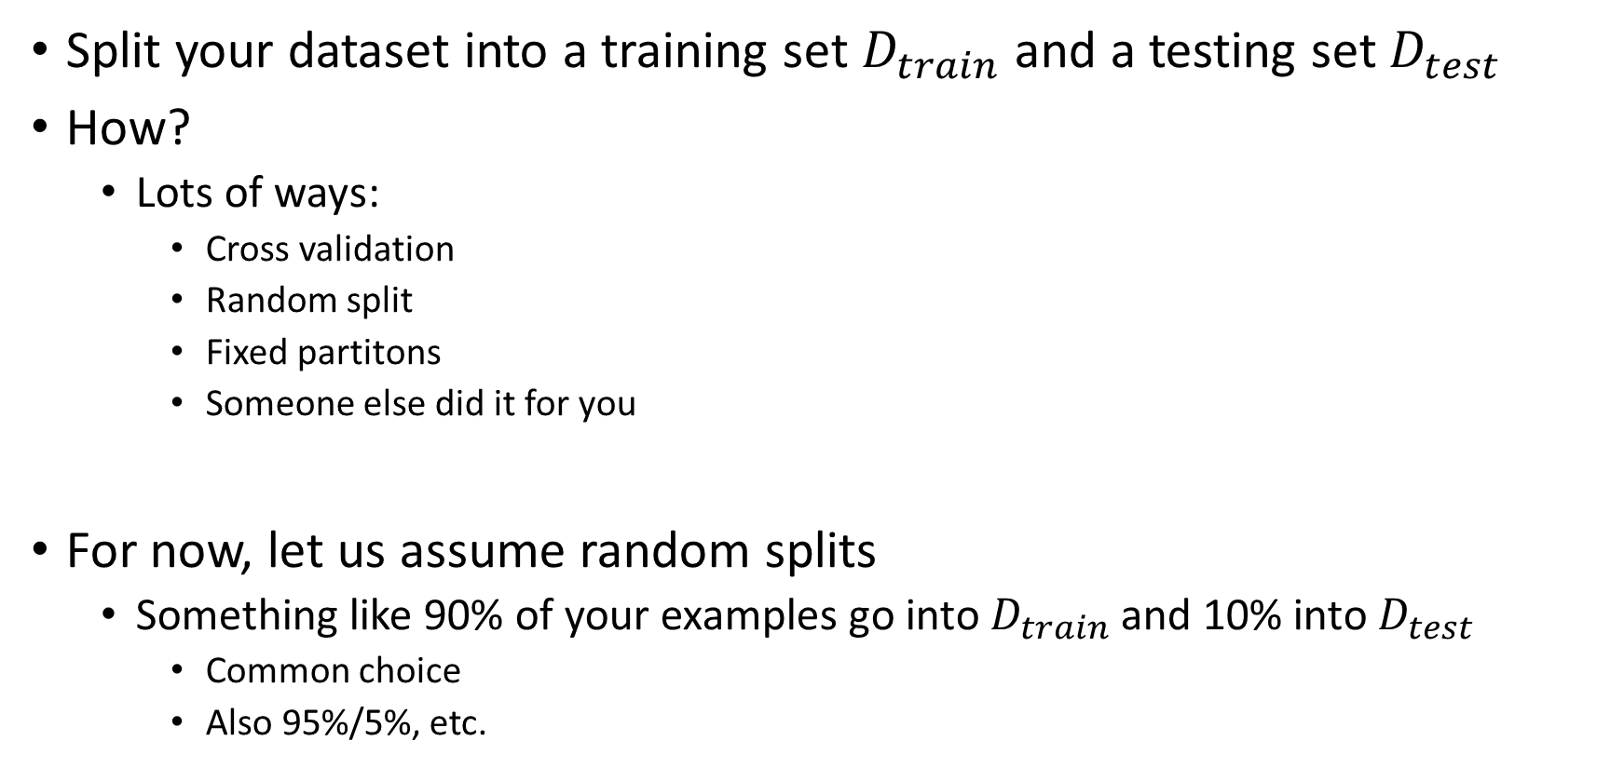
How to get Unseen Data?
Split your dataset into a training set $D_{train}$ and a testing set $D_{test}$
How?
Lots of ways:
Cross validation
Random split
Fixed partitons
Someone else did it for you
For now, let us assume random splits
Something like 90% of your examples go into $D_{train}$ and 10% into $D_{test}$
Common choice
Also 95%/5%, etc.

Slide 9
Generalization
How can we expect to do well on unseen data?
The function cannot learn from the unseen data…that’s cheating
Ockham’s razor? (Prefer simpler functions over more complicated ones?)
Can we estimate the likelihood of our model (given our data)?

Slide 10
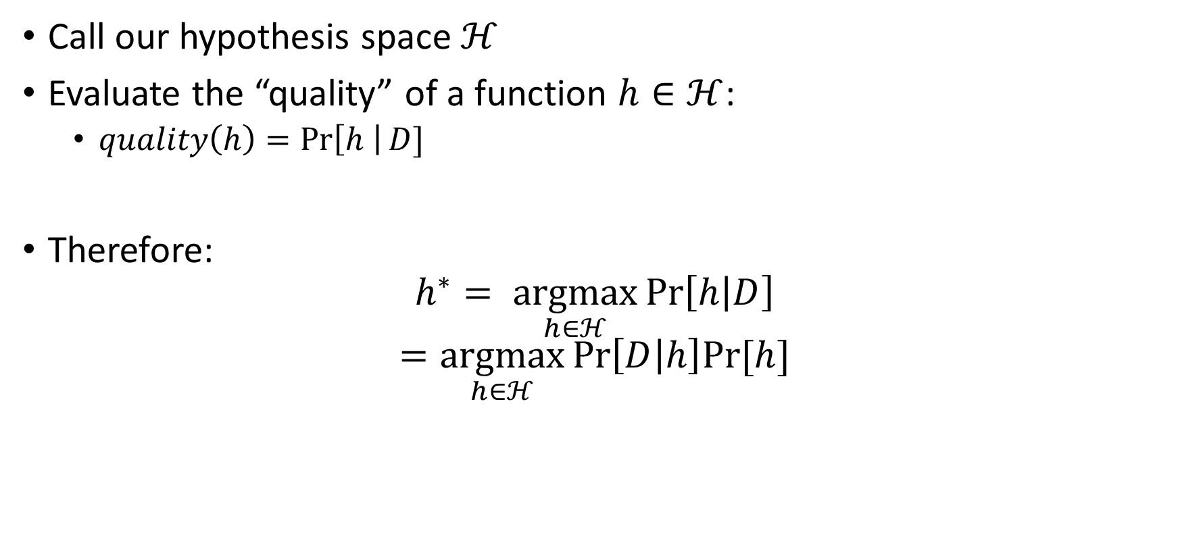
The Learning Objective
Call our hypothesis space $ℋ$
Evaluate the “quality” of a function $h∈ℋ$:
$quality\left(h\right)=\operatorname{Pr}\left[h \right|D]$
Therefore:
$$h^{∗}= \underset{h∈ℋ}{argmax}{\operatorname{Pr}\left[h | D\right]}$$
$$=\underset{h∈ℋ}{argmax}{\operatorname{Pr}\left[D | h\right]Pr⁡[h]}$$

Slide 11
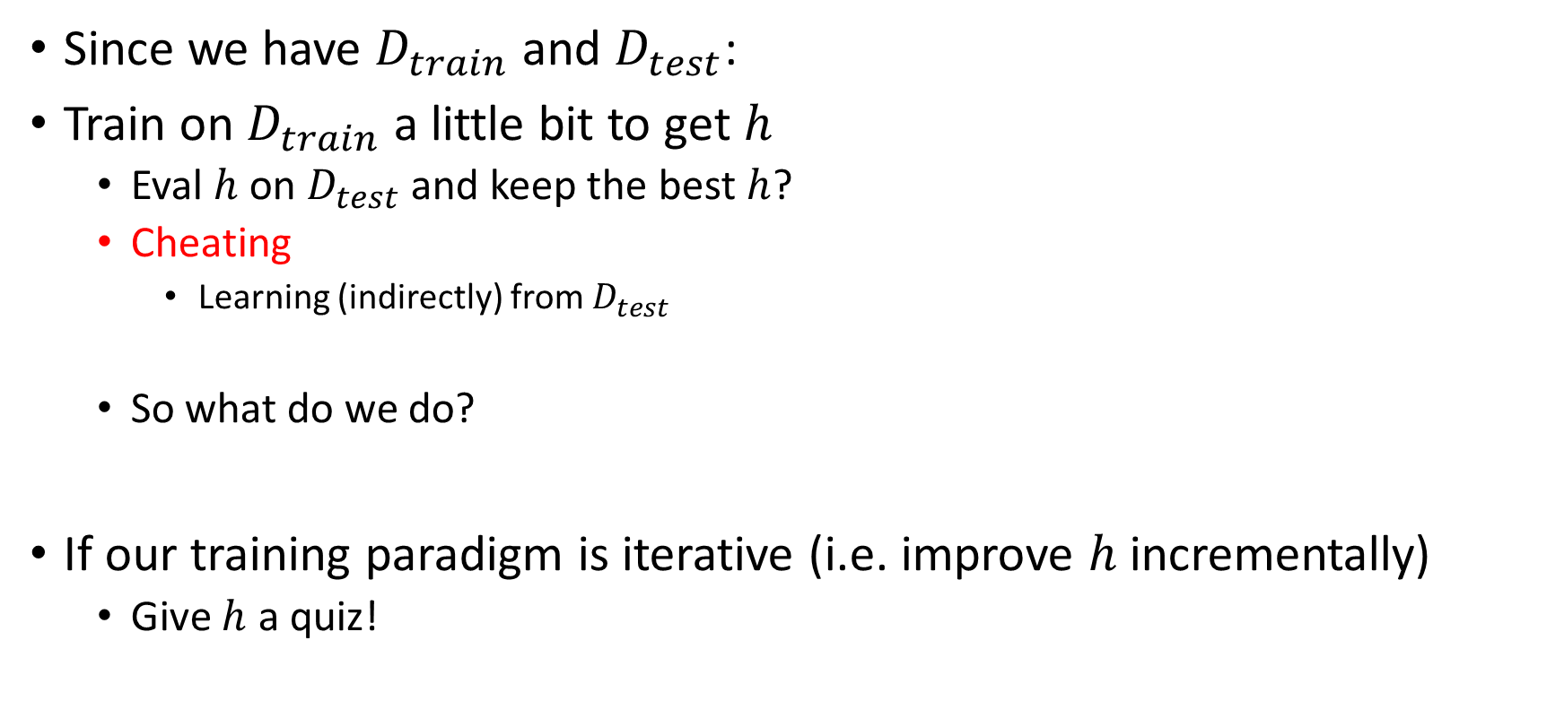
How to Evaluate the Learning Objective
Since we have $D_{train}$ and $D_{test}$:
Train on $D_{train}$ a little bit to get $h$
Eval $h$ on $D_{test}$ and keep the best $h$?
Cheating
Learning (indirectly) from $D_{test}$
So what do we do?
If our training paradigm is iterative (i.e. improve $h$ incrementally)
Give $h$ a quiz!

Slide 12
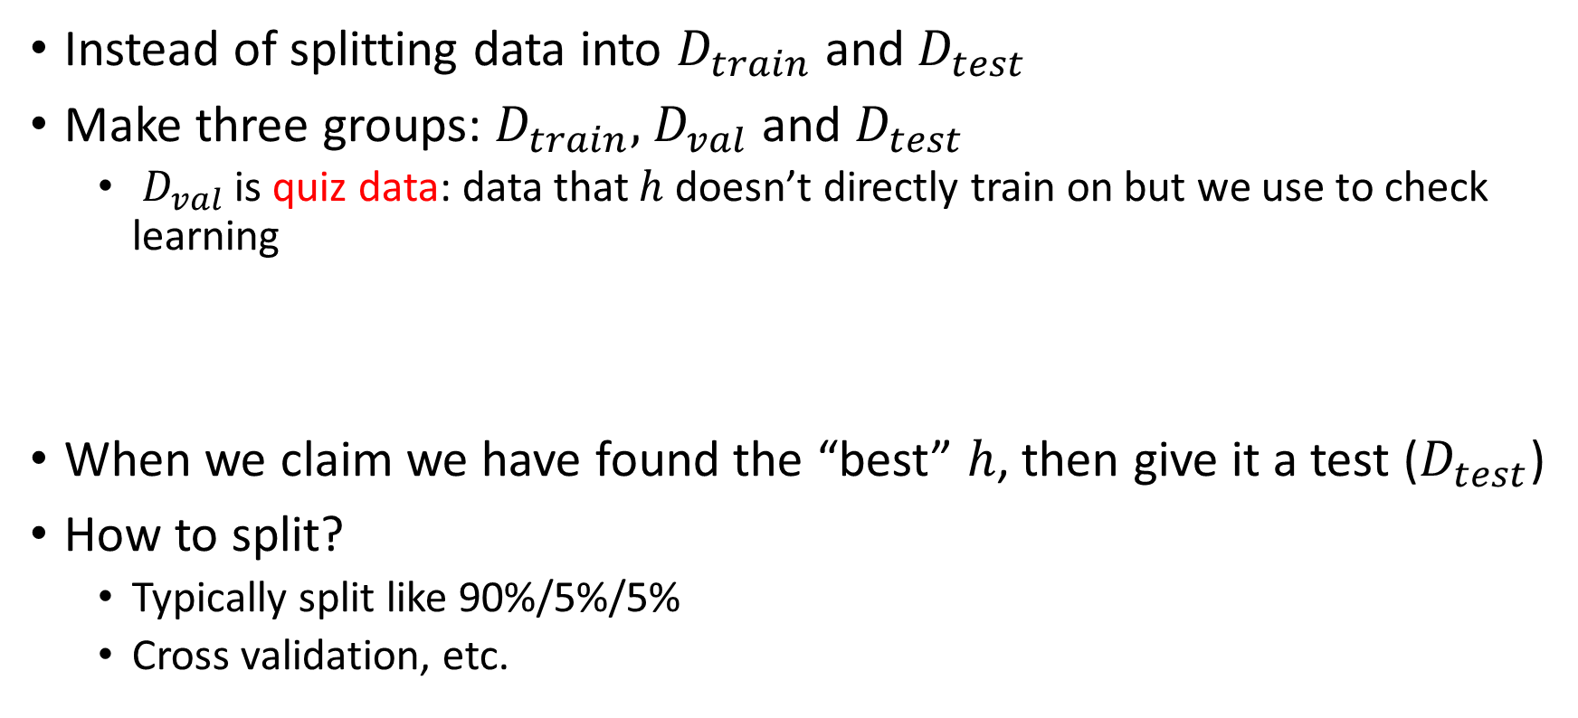
Training/Validation/Testing Data
Instead of splitting data into $D_{train}$ and $D_{test}$
Make three groups: $D_{train}, { D}_{val}$ and $D_{test}$
${ D}_{val}$ is quiz data: data that $h$ doesn’t directly train on but we use to check learning
When we claim we have found the “best” $h$, then give it a test ($D_{test}$)
How to split?
Typically split like 90%/5%/5%
Cross validation, etc.

Slide 13

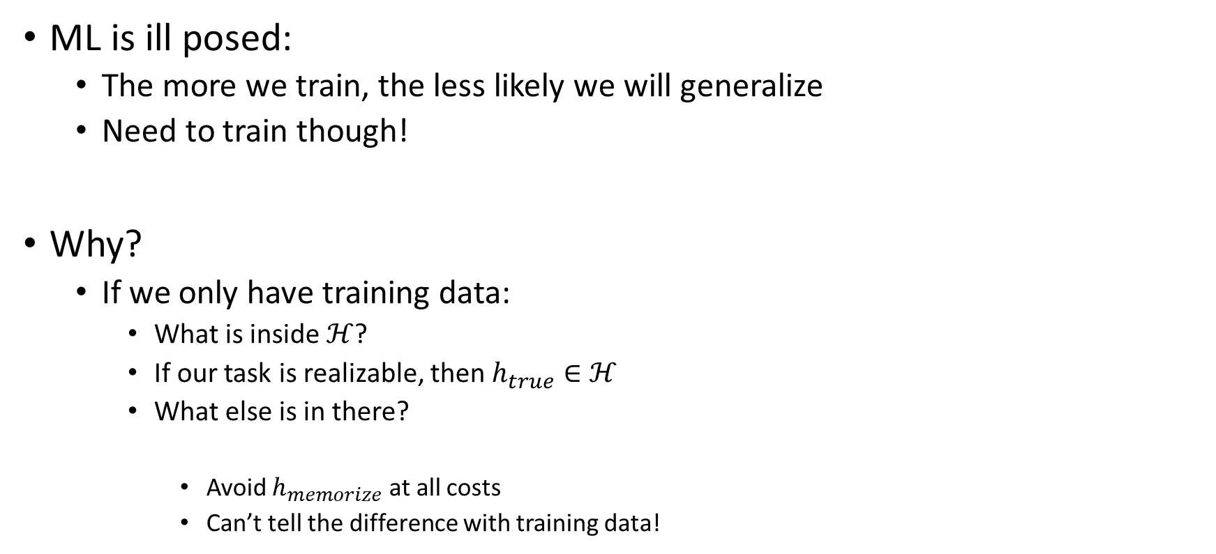
The Problem
ML is ill posed:
The more we train, the less likely we will generalize
Need to train though!
Why?
If we only have training data:
What is inside $ℋ$?
If our task is realizable, then $h_{true}∈ℋ$
What else is in there?
Avoid $h_{memorize}$ at all costs
Can’t tell the difference with training data!
training
generalization

